Slide 1
How Stable Are Corporate Capital Structures?
Harry DeAngelo
University of Southern California
Richard Roll
Caltech
Presented by Austin Francis

Slide 2
Research Question
How stable are corporate capital structures?

Slide 3
Prior Literature
Prior literature suggests that firm fixed effects are highly significant in explaining capital structure. It is concluded that firms with high or low leverage tend to remain at that level for over two decades. (Lemmon, Roberts, Zender, 2008)
Leverage stays in a narrow range over long periods of time. (Frank and Goyal, 2008)

Slide 4
Data Collection
15,096 firms from CRSP/Compustat database from 1950-2008.
Hand collected data for 24 DJIA firms back to before the great depression.

Slide 5
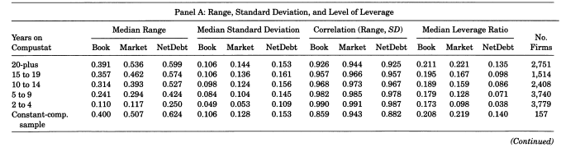
Table 1 – Time-Series Variation in Leverage
Notes:
The variable TED Spread is used to measure the degree of financial frictions and is computed as the difference between the interest rates on inter-bank loans and short-term US government T-Bills.
TED is derived from the variable TED Spread and is the 3-year moving average of the TED Spread.

Slide 6
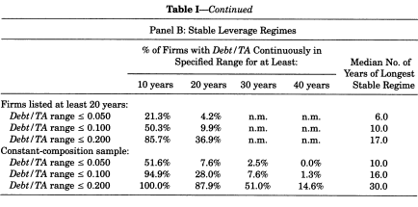
Table 1 – Time-Series Variation in Leverage
Notes:
The variable TED Spread is used to measure the degree of financial frictions and is computed as the difference between the interest rates on inter-bank loans and short-term US government T-Bills.
TED is derived from the variable TED Spread and is the 3-year moving average of the TED Spread.

Slide 7
Table 1 Takeaways
Capital Structure within a firm changes over time
There are periods of relative structure stability, but they rarely last
Uncommon to see even weakly stable regimes that persist for 40 years.

Slide 8
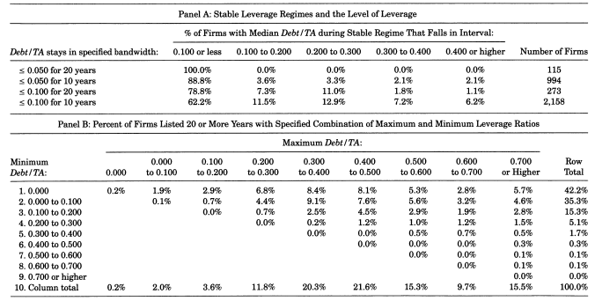
Table 2 – Stable Leverage Regimes and the Distribution of Firm-Specific Maximum and Minimum Leverage Ratios
Notes:
The variable TED Spread is used to measure the degree of financial frictions and is computed as the difference between the interest rates on inter-bank loans and short-term US government T-Bills.
TED is derived from the variable TED Spread and is the 3-year moving average of the TED Spread.

Slide 9
Table 2 Takeaways
When stable regimes do occur, they arise at low leverage.
Conservative leverage is observed at some point at a large majority of firms
High leverage is reasonably frequent, but almost always temporary
Notes:
The variable TED Spread is used to measure the degree of financial frictions and is computed as the difference between the interest rates on inter-bank loans and short-term US government T-Bills.
TED is derived from the variable TED Spread and is the 3-year moving average of the TED Spread.

Slide 10
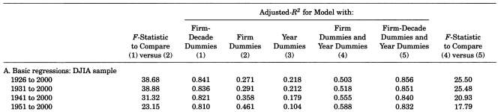
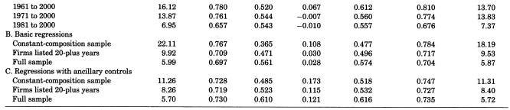
Table 3 – Explanatory Power of Firm and Year Main Effects and Firm-Time Interaction Effects
Notes:
The variable TED Spread is used to measure the degree of financial frictions and is computed as the difference between the interest rates on inter-bank loans and short-term US government T-Bills.
TED is derived from the variable TED Spread and is the 3-year moving average of the TED Spread.

Slide 11
Table 3 Takeaways
Firm + Time interaction effects have the highest R2 values
Leverage is firm specific for a given time
There is a short panel effect, over half of the firms in the sample have 9 or fewer years of data, overinflating firm fixed effects
Notes:
The variable TED Spread is used to measure the degree of financial frictions and is computed as the difference between the interest rates on inter-bank loans and short-term US government T-Bills.
TED is derived from the variable TED Spread and is the 3-year moving average of the TED Spread.

Slide 12
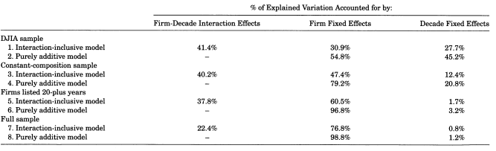
Table 4 – Explanatory Power of Firm Fixed Effects, Decade Fixed Effects, and Firm-Decade Interaction Effects
Notes:
The variable TED Spread is used to measure the degree of financial frictions and is computed as the difference between the interest rates on inter-bank loans and short-term US government T-Bills.
TED is derived from the variable TED Spread and is the 3-year moving average of the TED Spread.

Slide 13
Table 4 Takeaways
Firm effects are less important when including a time interaction

Slide 14
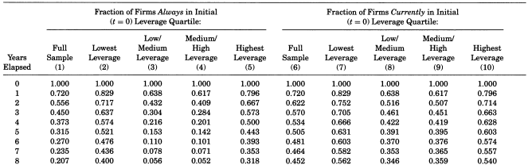
Table 5 – Migration over the Cross-Section: Fraction of Firms Always in and Currently in Their Initial Leverage Quartile
Notes:
The variable TED Spread is used to measure the degree of financial frictions and is computed as the difference between the interest rates on inter-bank loans and short-term US government T-Bills.
TED is derived from the variable TED Spread and is the 3-year moving average of the TED Spread.

Slide 15
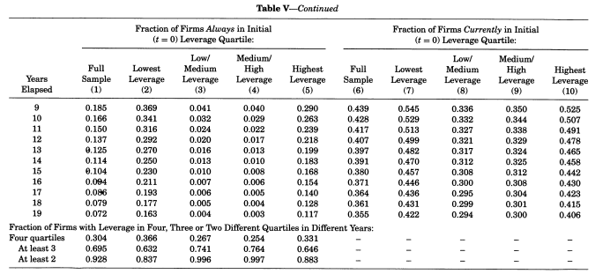
Table 5 – Migration over the Cross-Section: Fraction of Firms Always in and Currently in Their Initial Leverage Quartile
Notes:
The variable TED Spread is used to measure the degree of financial frictions and is computed as the difference between the interest rates on inter-bank loans and short-term US government T-Bills.
TED is derived from the variable TED Spread and is the 3-year moving average of the TED Spread.

Slide 16
Table 5 Takeaways
Firms show a modest reversion to their original leverage quartiles over time
Significant movement of firms across different leverage quartiles
Leverage stability is weak over long term horizons

Slide 17
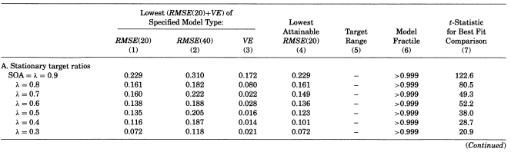
Table 6 – Alternative Models of Leverage Behavior and Instability of the Cross-Section
Notes:
The variable TED Spread is used to measure the degree of financial frictions and is computed as the difference between the interest rates on inter-bank loans and short-term US government T-Bills.
TED is derived from the variable TED Spread and is the 3-year moving average of the TED Spread.

Slide 18
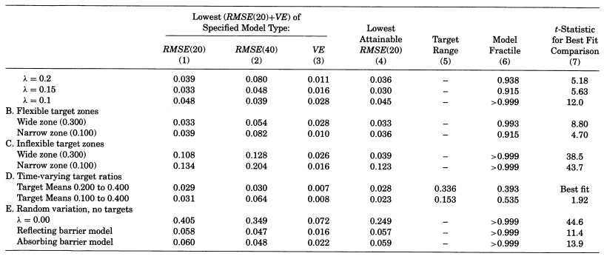
Table 6 – Alternative Models of Leverage Behavior and Instability of the Cross-Section
Notes:
The variable TED Spread is used to measure the degree of financial frictions and is computed as the difference between the interest rates on inter-bank loans and short-term US government T-Bills.
TED is derived from the variable TED Spread and is the 3-year moving average of the TED Spread.

Slide 19
Table 6 Takeaways
Neutral mutation model performs poorly
SOA models fit better, indicating firms slowly adjust their leverage toward target ratios
Random variation alone cannot explain leverage behavior

Slide 20
Table 6 Takeaways
Flexible zone models perform well. Time Varying Target models excel!
All credible models here share the common element of targeting behavior, with firms adjusting their leverage withing certain zones

Slide 21
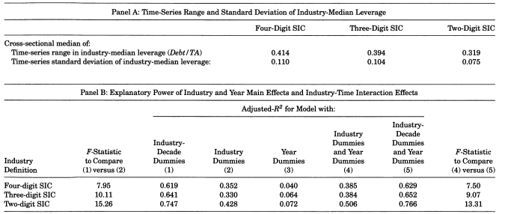
Table 7 – Industry-Median Leverage: Time Series Variation, ANOVA Tests, and Variance Decompositions
Notes:
The variable TED Spread is used to measure the degree of financial frictions and is computed as the difference between the interest rates on inter-bank loans and short-term US government T-Bills.
TED is derived from the variable TED Spread and is the 3-year moving average of the TED Spread.

Slide 22
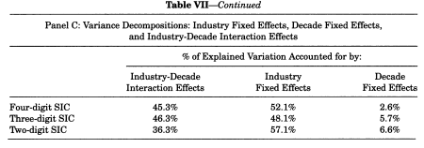
Table 7 – Industry-Median Leverage: Time Series Variation, ANOVA Tests, and Variance Decompositions
Notes:
The variable TED Spread is used to measure the degree of financial frictions and is computed as the difference between the interest rates on inter-bank loans and short-term US government T-Bills.
TED is derived from the variable TED Spread and is the 3-year moving average of the TED Spread.

Slide 23
Table 7 Takeaways
There is significant industry wide variation in leverage throughout time
Industry specific time series variations are as important as cross industry differences.

Slide 24
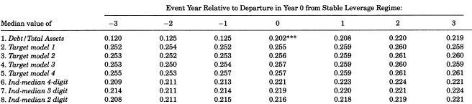

Table 8 – Target Leverage Variation and Departures from Stable Leverage Regimes
Notes:
The variable TED Spread is used to measure the degree of financial frictions and is computed as the difference between the interest rates on inter-bank loans and short-term US government T-Bills.
TED is derived from the variable TED Spread and is the 3-year moving average of the TED Spread.

Slide 25
Table 8 Takeaways
Large changes in leverage around stable regimes are driven by managerial choices
Closely associated with company expansion and investment policies.

Slide 26
Conclusion
Leverage Variation is Complex
This paper challenges existing theories
Time-Varying Targets Offer a better fit

